Slide 1
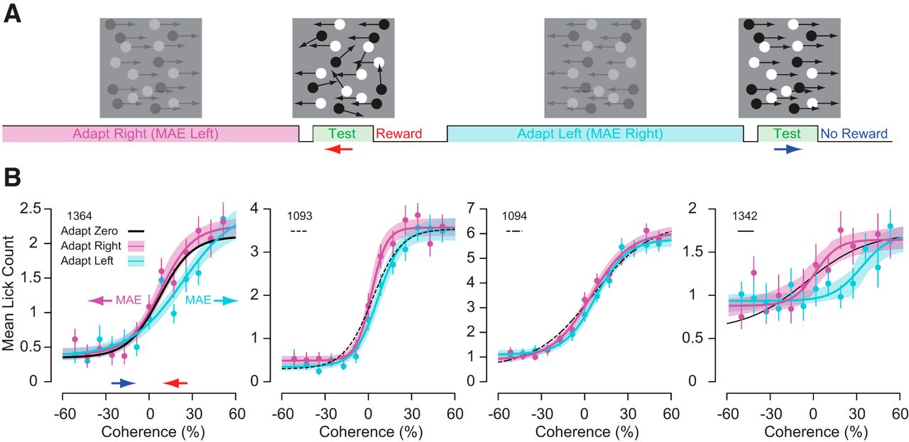
Motion discrimination is biased by previous prolonged exposure to motion stimuli.
Jason M. Samonds et al. eNeuro 2018;5:ENEURO.0065-18.2018
©2018 by Society for Neuroscience
Notes:
Motion discrimination is biased by previous prolonged exposure to motion stimuli. A, Mice were shown a 30% contrast fully coherent adapting stimulus for at least 10 s before being shown a 4 s 100% contrast test stimulus of varying coherence. B, Mean lick counts for rightward (magenta) and leftward (cyan) adapting conditions. The corresponding sigmoid fits from Figure 4B for zero coherence adapted lick counts versus coherence are displayed as solid and dashed black lines. The mice licked more for rightward adapting stimuli (magenta) because this should produce a leftward motion aftereffect, which corresponds to the rewarded condition. The mice licked less for leftward adapting stimuli (cyan) because this should produce a rightward motion aftereffect, which corresponds to the unrewarded condition. Error bars are SE and shaded bands for magenta and cyan lines are the bootstrapped SE of sigmoid fits (n = 62–70 repeats for each condition).

